Slide 1
IMAGE COMPRESSION

Slide 2
Introduction
Process of reducing or compressing size and image data files but still retaining important information.
compressed file is used to reconstruct image
relationship between compressed and uncompressed file is denoted as the compression ratio

Slide 3
Compression Ratio
Compression ratio is defined as ratio of uncompressed file size to compressed file size.
Compression Ratio=
Uncompressed file size
Compressed File Size

Slide 4
Types of Data Compression
There are two types of Data Compression:
Lossless Compression
Lossy Compression

Slide 5
Lossy Compression
In order to achieve higher rates of compression, we give up complete reconstruction and consider lossy compression techniques
The reason is that our eyes and ears cannot distinguish subtle changes.
The compressed data is not the same as the original data, but a close approximation of it.
Yields a much higher compression ratio than that of lossless compression.

Slide 6
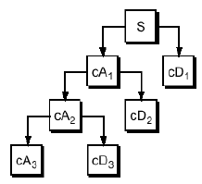
Wavelet Decomposition
The decomposition process can be iterated, with successive approximations being decomposed in turn, so that one signal is broken down into many lower-resolution components. This is called the wavelet decomposition tree.

Slide 7
Low & High Frequency
Low-frequency content- Identity of signal
They contains most important part of signal.

Slide 8
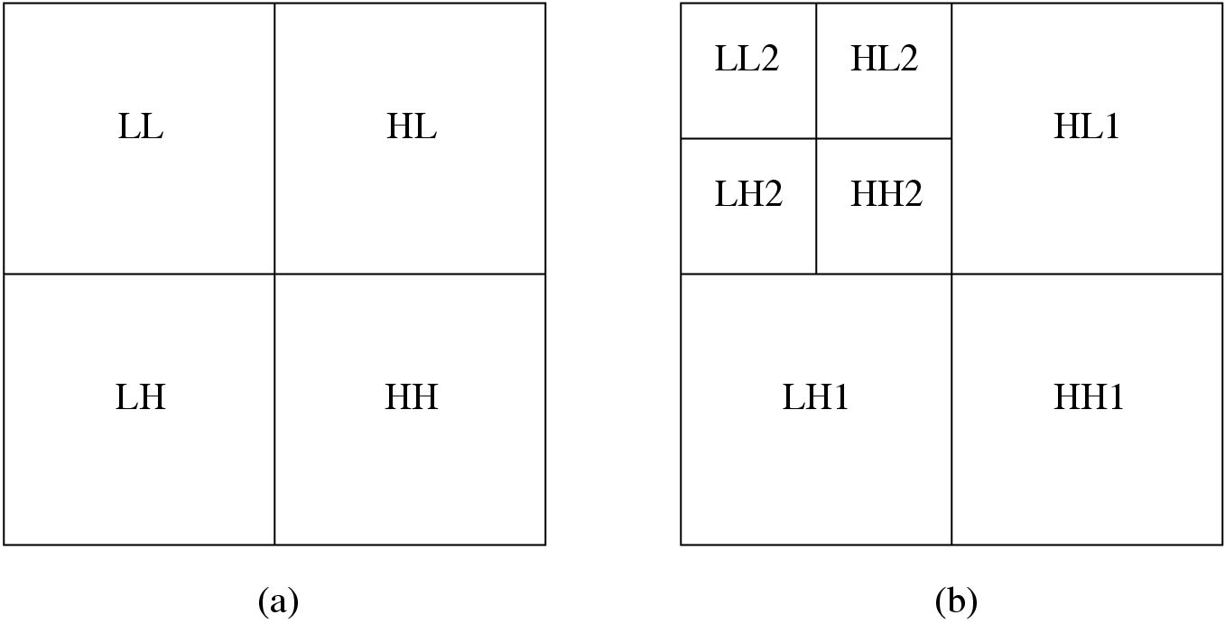
Fig. 8.19: The two-dimensional discrete wavelet transform
(a) One level transform, (b) two level transform.

Slide 9
8.6 Wavelet-Based Coding
The objective of the wavelet transform is to decompose the input signal into components that are easier to deal with, have special interpretations, or have some components that can be thresholded away, for compression purposes.
We want to be able to at least approximately reconstruct the original signal given these components.
The basis functions of the wavelet transform are localized in both time and frequency.
There are two types of wavelet transforms: the continuous wavelet transform (CWT) and the discrete wavelet transform (DWT).

Slide 10
Steps Involved
Input the Image.
Convert it to gray scale.
Input the and decomposition level.
A wavelet decomposition of the image.
Compression of image.
Decompression of image.

Slide 11
Steps Involved…..
Plot the original and compressed image.
Display the results.
Compute the image size.

Slide 12
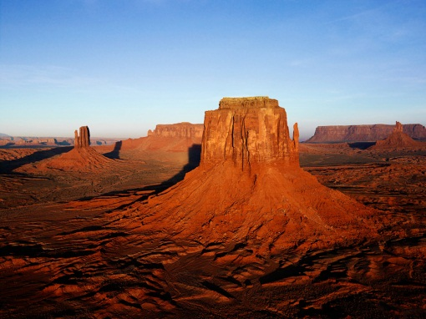

Steps Involved…..
Wavelet Transformation
Original Image
Compressed Image

Slide 13
References
Google
Youtube

Slide 14
Thank You

